Slide 1
UNIT FOUR MODELLING OF CONTROL COMPONENTS
DR (MRS) E. A. ADJEI

Slide 2
MODELLING
Models are mathematical representations of system dynamics.
• Models allow the dynamics of systems to be simulated and analyzed, without having to build the system.
• Models are never exact but they can be predictive.
Different types of models are used for different purposes.
• Ordinary differential equations for rigid body mechanics.
• Finite state machines for manufacturing, internet, information flow.
• Partial differential equations for fluid flow, solid machines, etc.

Slide 3
ADVANTAGES OF MODELS
Models can be used in ways the actual system can’t.
• Certain types of analysis (e.g., parametric variations) can’t easily be done on the actual system.
• In many cases, models can be run much more quickly than the actual models.
The model you use depends on the questions you want to answer.
1. A single system may have many models.
2. Time and spatial scale must be chosen to suit the questions you want to answer.
3. Always formulate questions before building a model.

Slide 4
STEPS IN MODELING
1. Understand the physical system and its components.
2. Make appropriate simplifying assumptions.
3. Use basic principles to formulate the mathematical model.
4. Write differential and algebraic equations describing the model.
5. Check the model for validity.
What will the model be used for?
1. Solution of the differential and algebraic equations allows system response and performance to be analyzed and designed.
2. The Laplace transformation will be applied to the model to allow convenient manipulation and dynamic analysis.
3. Input – output relationships for systems and components will be obtained.

Slide 5
MECHANICAL SYSTEM
Consider a mass, M, on a frictionless surface connected to a rigid wall by a spring with stiffness, K.
spring K (N/m)
Need a model for the position of the mass as a function of time.
mass
M (Kg)

Slide 6
ANALYSIS OF PHYSICAL SYSTEMS
1. Choose a sign convention for the position variable y(t). Note that the sign convention for velocity and acceleration are the same as that for the displacement.
y(t)
spring K (N/m)
2. Use fundamental physical principles to model the system. (Newton’s Law).
3. Draw free – body diagram of the system. In this example, the spring force is the only force acting on the mass
y(t)
Ky(t)
mass
M (Kg)
M (Kg)

Slide 7
ANALYSIS OF PHYSICAL SYSTEMS
4. Spring exerts a force proportional to and in opposition to movement of the mass. From Newton’s Law ∑F=Ma
5. Obtain differential equation
W_{n} is the undamped natural frequency
6. System characteristics . The system has no input. No external force acts on the mass. In the differential equation, this is indicated by the zero on the right-hand side. The system has no damping. There is no energy dissipation in the system

Slide 8
SPRING – MASS DAMPER
y(t) x(t)
Dashpot C(Ns/m) spring K (N/m)
Mass is perturbed by manipulating end position x(t) of the spring with stiffness K.
Dashpot with damping co-efficient C resists motion in proportion to velocity
mass
M (Kg)

Slide 9
FREE – BODY DIAGRAM
y(t)
Fd (N) Fs (N)
Expression equation
M (Kg)

Slide 10
CONTROL COMPONENTS
This section presents methods for writing the differential equations for variety of electrical, mechanical, thermal, hydraulic systems, etc. the basic physical laws are given for each system, and the associated parameters are defined.
The result is a differential equation or a set of differential equations that describes the system. The equations derived are limited to linear system or to systems that can be represented by linear equations over their useful operating range.

Slide 11
ELECTRICAL CIRCUITS AND COMPONENTS
The equations for an electric circuit obey Kirchhoff’s Law, which state the following:
1. The algebraic sum of the potential differences around a closed path equals zero.
2. The algebraic sum of the currents entering or leaving a node is equal to zero. In other words, the sum of currents entering the junction equals the sum of the currents leaving the junction.
The voltage sources are usually alternating (AC) or direct current (DC) generators. The usual dc voltage source is a battery. The voltage drops appear across the three basic electrical elements: Resistors, Inductors, and Capacitors. These elements have constant components values.

Slide 12
ELECTRICAL CIRCUITS AND COMPONENTS
The voltage drop across a Resistor is given by Ohm’s Law, which states that the voltage drop across a resistor is equal to the product of the current through the resistor and its resistance. Resistors absorb energy from the system. Symbolically, this voltage is written as VR = Ri
The voltage drop across an inductor is given by Henry’s Law, which is written as VL= Ldi/dt = LDi.. This equation states that the voltage drop across an inductor is equal to the product of the inductance and the time rate of change of the current. A positive valued derivative Di, implies an increasing current, and thus a negative voltage.

Slide 13
ELECTRICAL CIRCUITS AND COMPONENTS
The voltage drop across a capacitor is defined by Faraday’s Law. The positively directed voltage drop across a capacitor is defined as the ratio of the magnitude of the positive electric charge on its positive plate to the value of its capacitance. Its direction is from the positive plate to the negative plate.
The charge on a capacitor plate is equal to the time integral of the current entering the plate from the initial instant to the arbitrary time, t, plus the initial value of the charge. The capacitor voltage is written in the form

Slide 14
Electrical Symbols and Units
Units for these electrical quantities in the practical system are given in the table below.
Table 1: Electrical Symbols and Units
SYMBOL | QUANTITY | UNIT
e or V | Voltage | Volts
I | Current | Amperes
L | Inductance | Henrys
C | Capacitance | Farads
R | resistance | Ohms

Slide 15
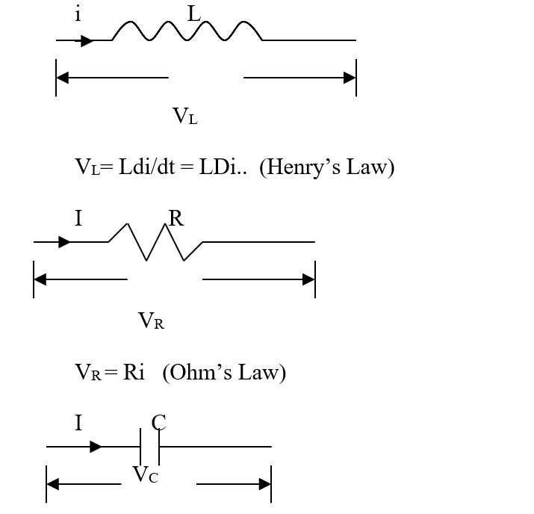
SUMMARY
The ratio V/i = impedance, it is denoted by Z
Z_{L}= LS where S = d/dt. (Inductance)
Z_{R} = R (Resistance)
Z_{c} = 1/CS (Capacitance)
For series impedance
Z_{s} = Z₁ + Z₂ + Z₃ + ...
For parallel impedance
(1/Z_{p})= (1/ Z₁ +1/ Z₂ + 1/Z₃ + …)
(Faraday’s Law)

Slide 16
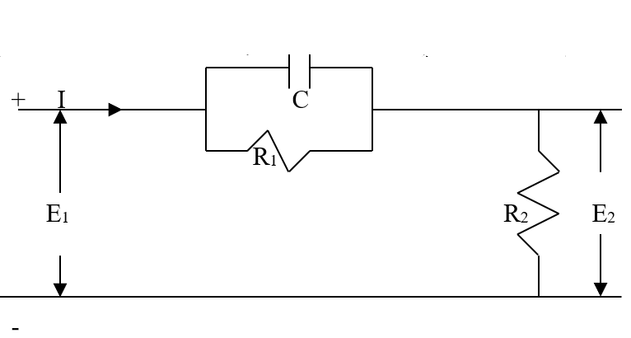
Example 1
For the circuit below, determine the equation relating the output to the input

Slide 17
Solution
The parallel combination of R₁ and C₁ is in series with R₂, so that the total impedance Z is Z = Z₁+Z₂
E = ZI which implies Z = E/I
The voltage are given as

Slide 18
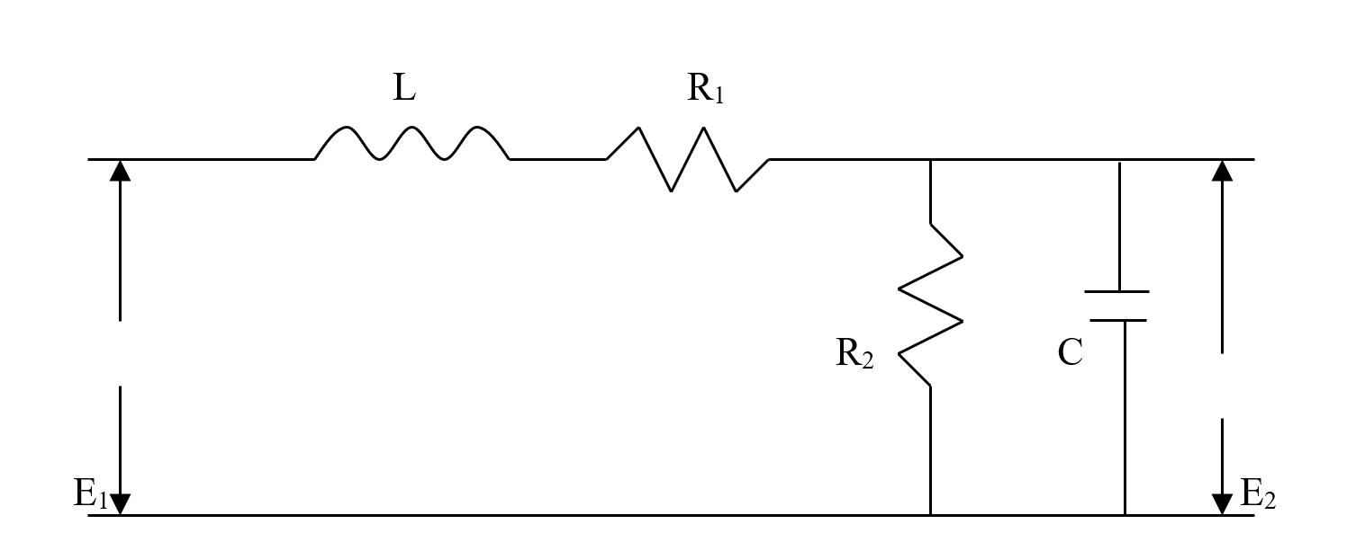
Example 2
Find the ratio of the output to the input for the circuit below

Slide 19
Solution

Slide 20
Thermal Systems
Liquid in glass thermometer: For a simple thermometer (or equivalent temperature measuring device) there is relationship between the indicated temperature and the temperature being measured.
Let θ_{i}(t) be the temperature of the fluid around the bulb, or the input, and θ₀(t) the temperature of the fluid in the thermometer be the system output.
The thermometer fluid volume will vary in proportion to its temperature, and the stem is graduated accordingly. The temperatures are both time varying and hence functions of time, t.

Slide 21
Thermal System
The rate of heat flow, q (t), into the thermometer fluid is proportional to the temperature difference across the walls.
Where K₁ is the thermal resistance and is determined by the coefficients of heat transfer from fluid to glass, through the glass and from glass to inner fluid. Also the rate of heat flow, q(t), is proportional to the rate of temperature rise of the thermometer fluid.
Where C is the specific heat and m is the mass of the thermometer fluid.

Slide 22
Thermal System
Taking Laplace transform of both sides
NB:
1. The thermal capacity of the glass has been assumed negligible and the overall coefficient of heat transfer assumed to be constant.
2. Also, the parameters have been considered to be lumped, which means that the thermometer fluid temperature has been assumed to be uniform in a spatial sense, as has the temperature of the fluid being measured. If the temperatures were to be considered as functions of both time and position, it would be necessary to describe the system by partial differential equations, and it would be termed as distributed parameter system.

Slide 23
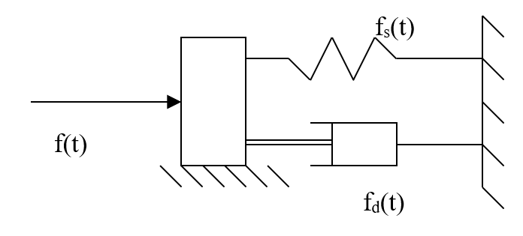
MASS – SPRING – DAMPER
A frequently occurring physical arrangement that can be represented by a force acting on a mass which is restrained by spring and viscous damper is shown diagrammatically in the figure below. It is assumed that the mass is constrained to move in the direction of the applied force by friction-free guiding surface.

Slide 24
MASS – SPRING – DAMPER
The basic physical law relating the position of the mass to the force acting upon it is Newton’s second law of motion which states as the sum of the applied forces is equal to the rate of change of the momentum of the system.
But spring force, fs(t) = Kx(t) and the damper force
f_{d}(t) = Cdx(t)/dt
Therefore

Slide 25
MASS – SPRING – DAMPER
For zero initial conditions, the Laplace transform is
The most general form of this equation, using dot notation for differentiation is
Where u (t) is the forcing term and is the system natural frequency and the symbol ζ is known as the damping factor. How such mass-spring-damper system react to a force, or respond to inputs of an electrical or other systems were shown in the time response.

Slide 26
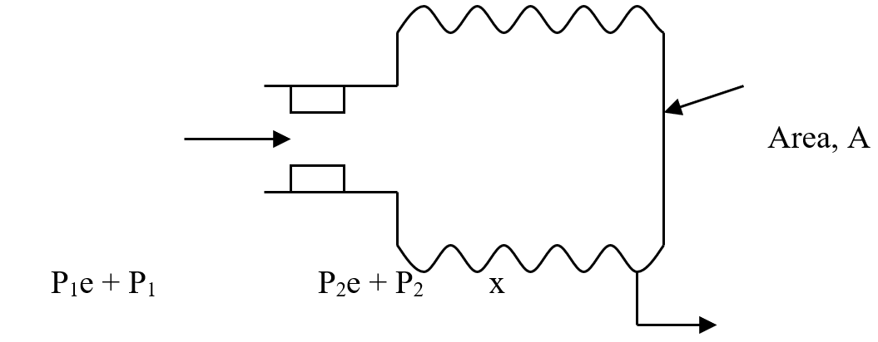
Pneumatic Bellows
For equilibrium position P1e = P2e
Let P1(t) and P2(t) and x(t) denote changes from equilibrium position. The mass flow rate is given by

Slide 27
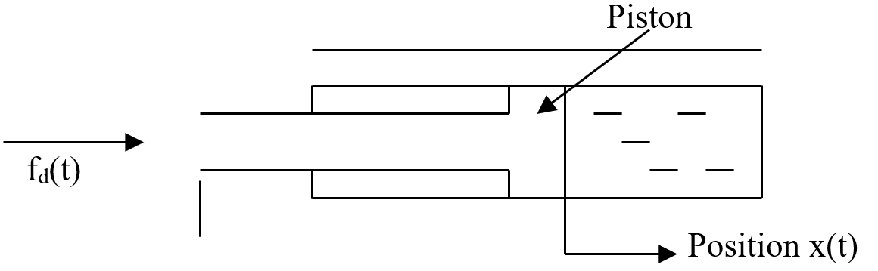
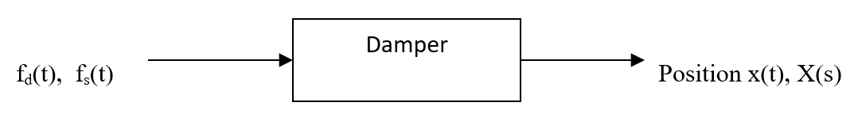
Ideal Hydraulic Damper
Consider a piston of negligible mass sliding with some clearance in an oil-filled cylinder under the action of a force fd(t) in the figure below.
Assumptions: there is a free flow through the piston so that no pressure difference can arise across the piston.

Slide 28
Ideal Hydraulic Damper
There will be a relationship between the position of the position x(t) and the applied force. Using basic physical considerations that the viscous drag on the piston is proportional to the velocity of the piston in the cylinder, fd(t) = Cdx(t)/dt, where C is the viscous damping coefficient with units of force per unit velocity.
Taking Laplace transform gives, for zero initial conditions Fd(s) = CsX(s). Hence the transfer function is

Slide 29
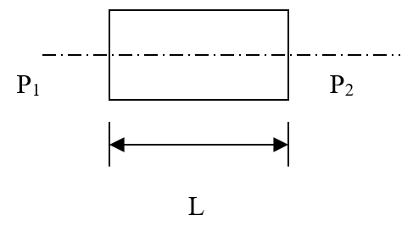
Hydraulic Inertance
Inertance force required to accelerate a column of fluid in pipe is A(P₁ - P₂)=mdv/dt

